Slide 1

Square Application Usage Guide
Please Download Guideline !

Slide 2

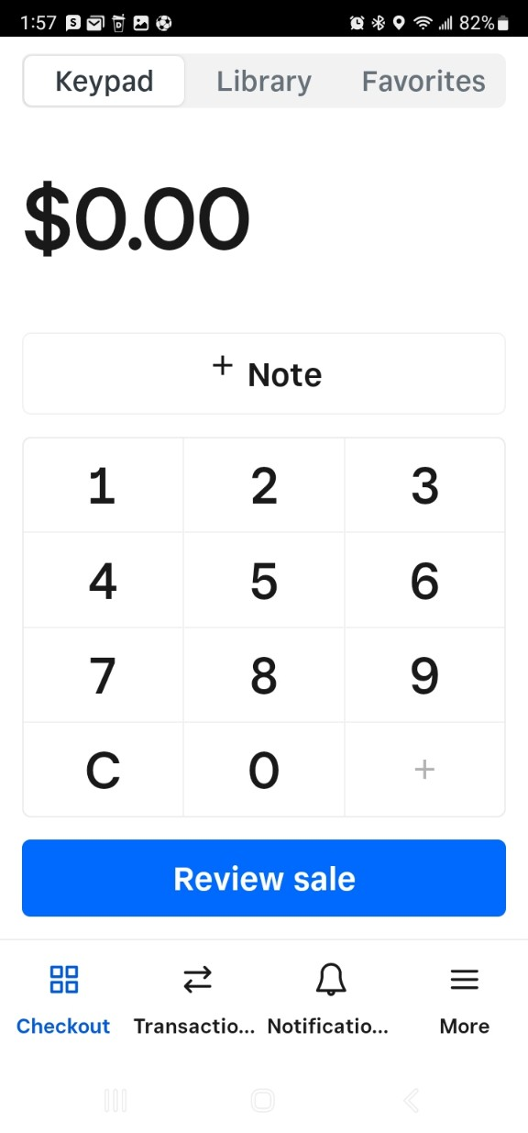
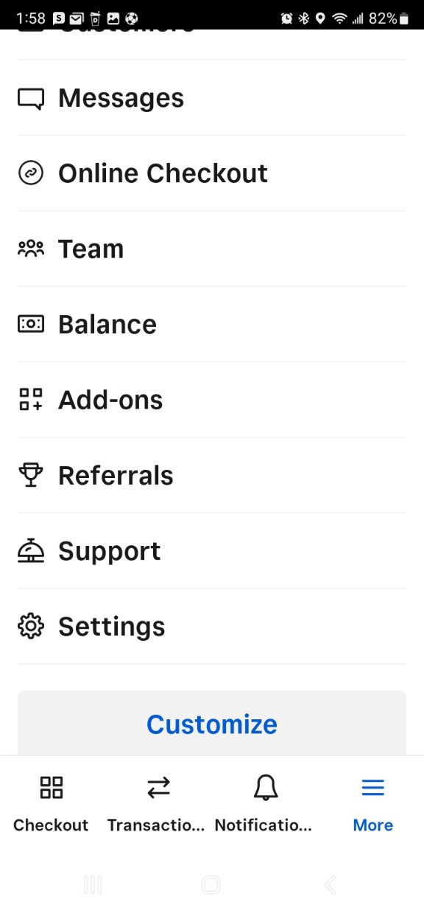
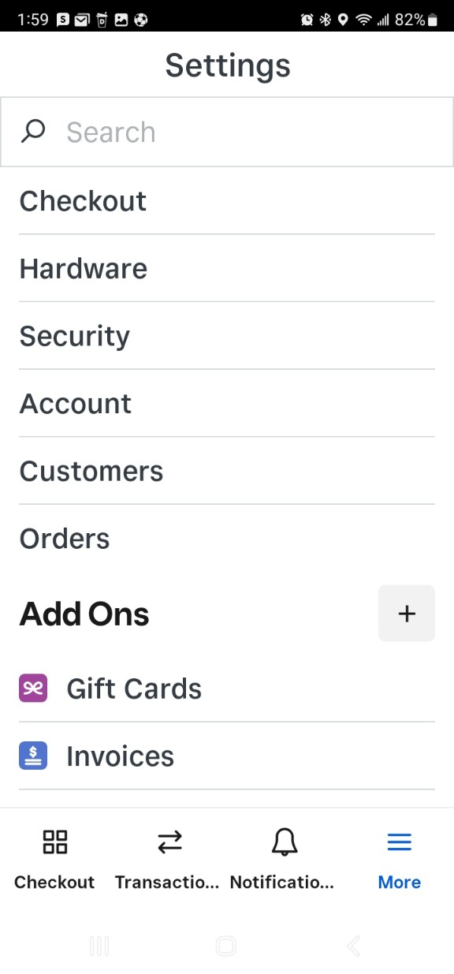


1. Touch “More”
1. Insert Device Name
2. Touch “Settings”
3. Touch “Hardware”

Slide 3
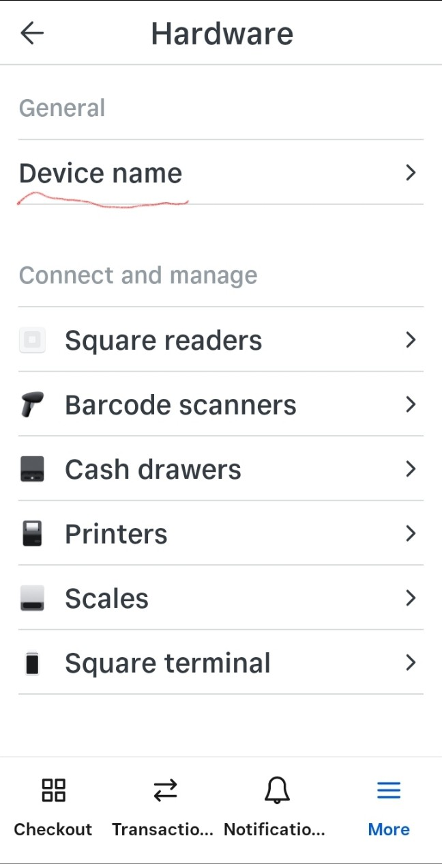
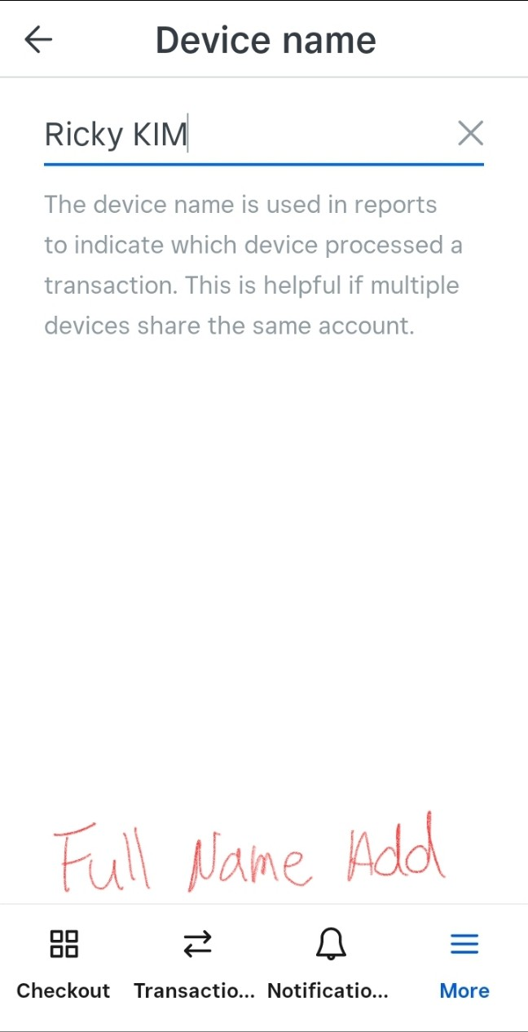

4. Touch “Device name”
1. Insert Device Name
5. Insert full name
Need to insert
“Your full name”

Slide 4
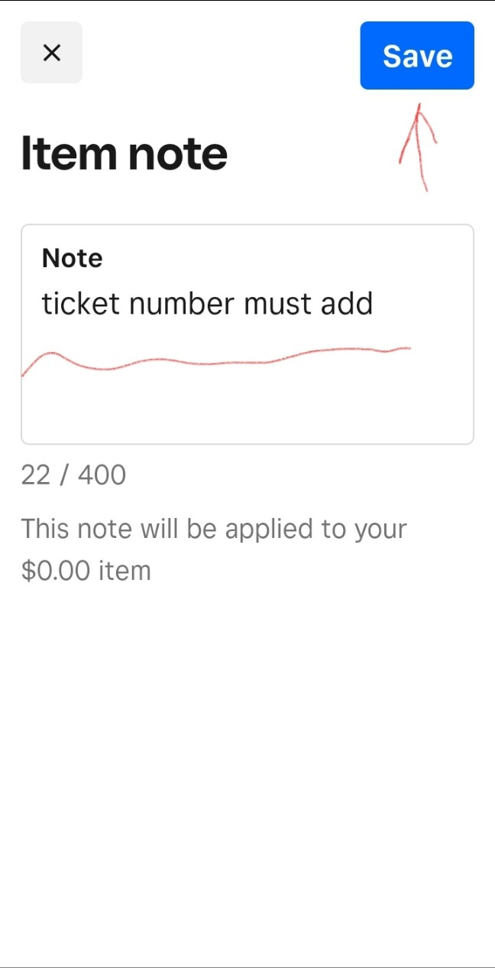
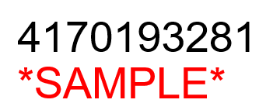
1. Touch “Note”
2. Insert Ticket #
2. Insert Ticket #
Need to insert
“Ticket Number”

Slide 5

1. Go to Square App
3. Initialize Tax Settings
2. Touch “More”
Scroll down and
touch “Settings”

Slide 6
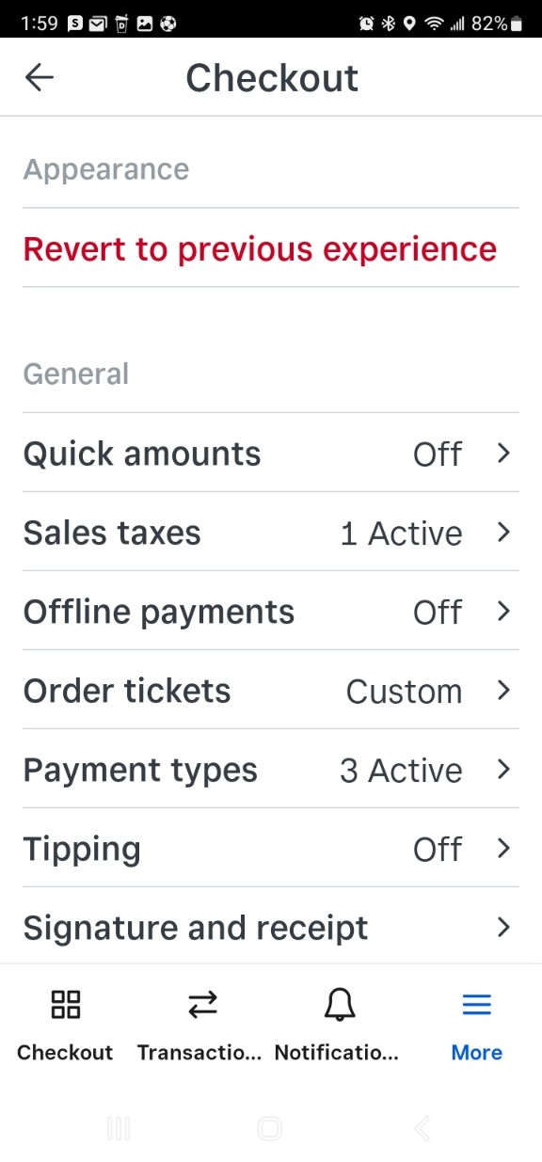
5. Check “Sales taxes” section
3. Initialize Tax Settings
4. Touch “Checkout”
If any sales taxes section is “Active” will manually calculate or amount plus tax !

Slide 7
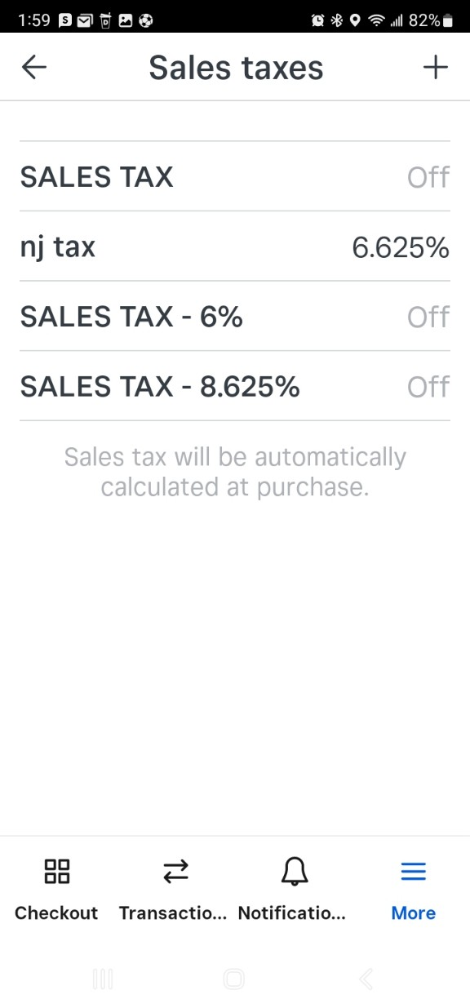
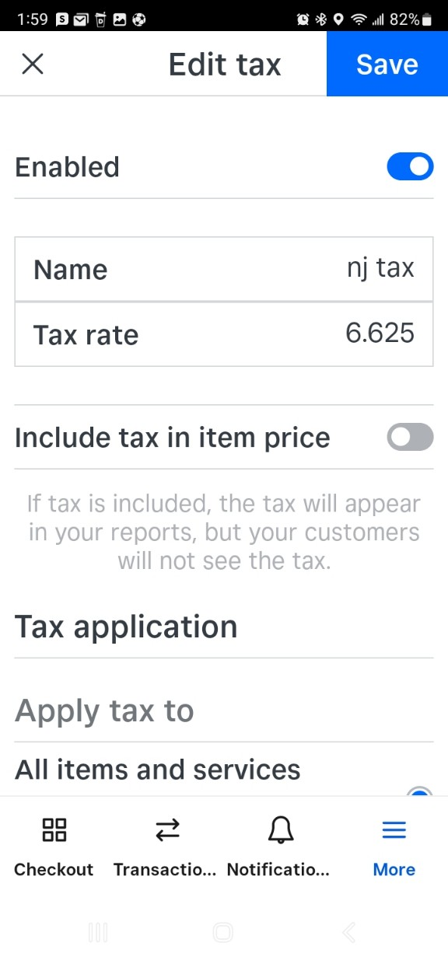


7. Turn off activated tax
3. Initialize Tax Settings
6. Touch activated sales tax
Touch “Enabled”
section bar and turn off.
2. Save it !

Slide 8


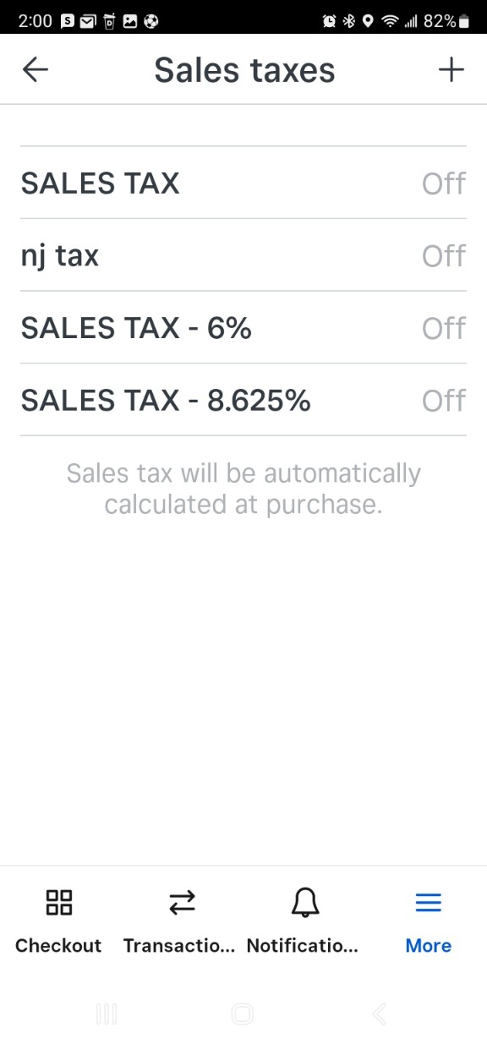
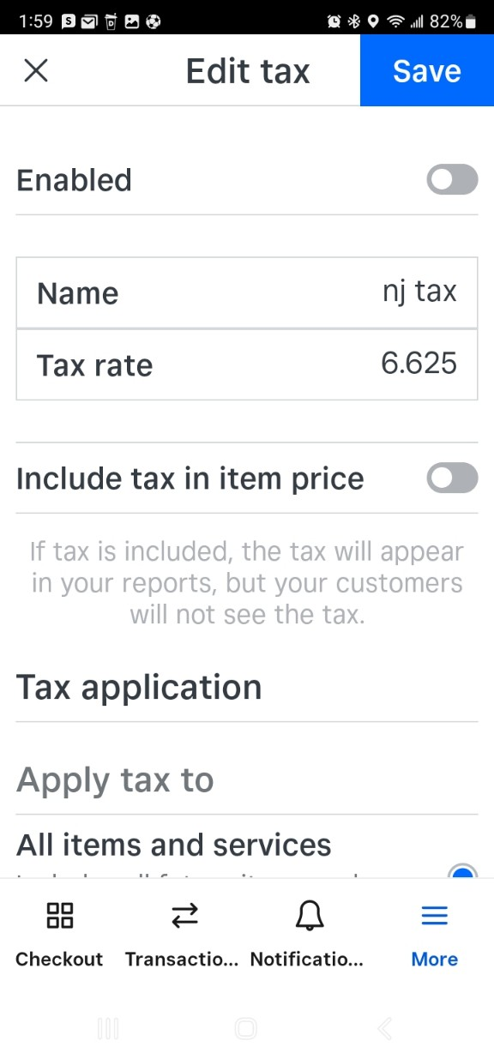

8. Check whether the tax status is “off”
3. Initialize Tax Settings
All Sales tax should be off !
Good to go now !

Slide 9
Tax rate per region
Region | Rate | etc
MA | 6.25% | Parts only
CT | 6.35% | -
NJ | 6.625% | -
PA | 6.00% | -
VT/MD/VA | 6.00% | Parts only
NYC | 8.625% | -
Upstate NY | 8.00% | -
FL | 6.00% | -
Please use this chart to charge TAX properly by each region.
Everything should be calculated refer to this chart.

Slide 10
Television Service Fees & Home Appliance Rate
Trip ($120) + Labor + Parts + Tax
HE (TV)
Size | Regular | Panel
Up to 49" | $ 190.00 (120+70) | $ 215.00 (120+95)
50-65" * | $ 210.00 (120+90) | $ 250.00 (120+130)
66-79" * | $ 260.00 (120+140) | $ 295.00 (120+175)
80" & up* | $ 410.00 (120+290) | $ 1,000.00 (120+880)
This is TV rate per size of TV.
We as HSN, charge TV and OOW differently.
Please be aware !!!
Trip
Labor
Trip
Labor
HA
HOME APPLIANCE FLAT LABOR RATE: |  | $120 Initial Trip / Diagnostic + $95 Labor => $215
MAJOR DRUM FLAT RATE: | $380 (120+160) | ONLY APPLICABLE FOR WASHERS [INCLUDES EXTRA MAN, > 2 HRS] / FLEX WASHER
OTHER APPLICABLE EXTENSIVE LABOR RATE: | $320 (2 HRS LABOR MIN: $120+200) | ICE BUILD-UP : TECHS PLEASE ADVISE CX TO MELT ICE PRIOR ARRIVAL
 |  | DISHWASHER: SUMP REPLACEMENT
 |  | GAS OVEN: GAS / SAFETY VALVE
 |  | REFRIGERATOR: LEFT DOOR [ALONE IS 1 HR] + ADD 'L DOORS
This is Home appliance labor rate.
Will get labor refer to the chart.
TV and Home appliances have different
Out of warranty rate. Please be aware !!!!!

Slide 11
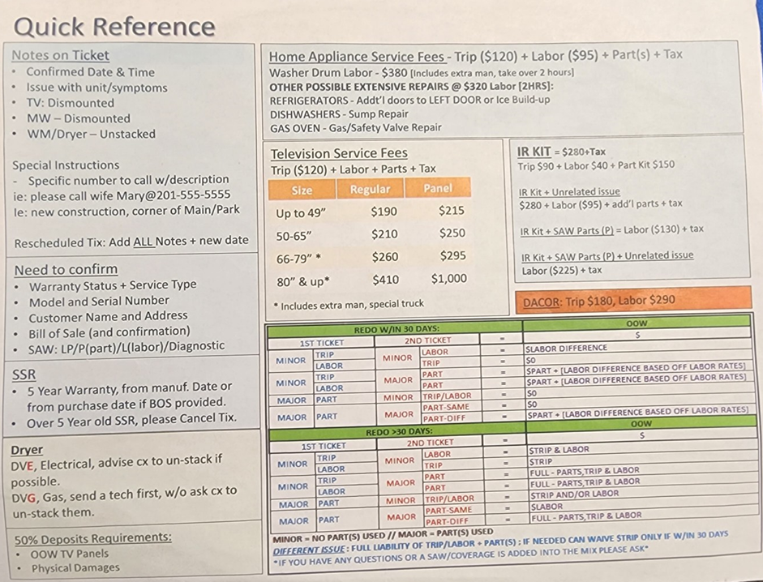
Quick Reference

